Slide 1
JavaScript Build Tools: Grunt, Gulp
by Iryna Bzdyr

Slide 2
Agenda
What is Gulp
Gulp workflow
Gulp API
Grunt
Grunt API

Slide 3
What is Gulp
Gulp is a task/build runner for development. It allows you to do a lot of stuff within your development workflow. You can compile sass/less files, uglify and compress js files and much more. The kicker for gulp is that its a streaming build system which doesn't write temp files. It's like Pipes in bash.
● Front-end developement tool
● Task automation in javascript
● Streaming build system

Slide 4
Why use Gulp
● Gulp solves the problem of repetition
● Bundling and minifying libraries and stylesheets
● Less/Sass to CSS compilation
● Copying modified files to an output directory
● Saving time

Slide 5
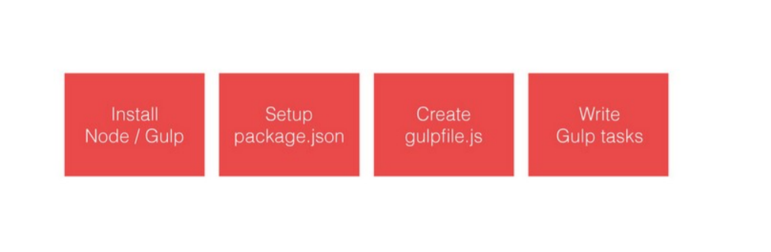
Gulp workflow

Slide 6
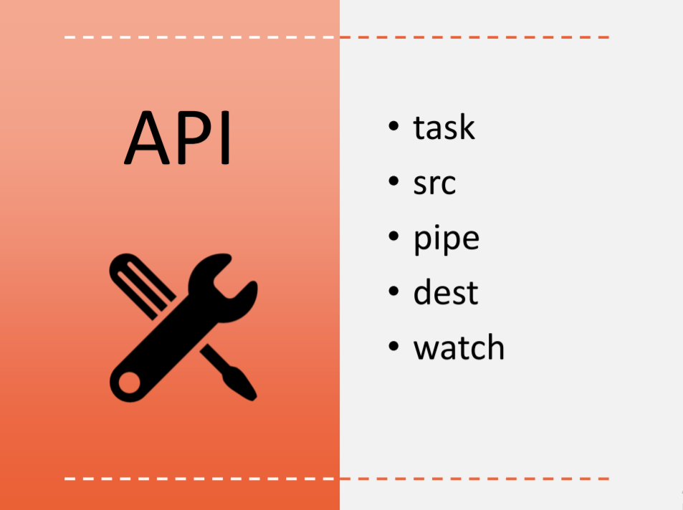

Slide 7
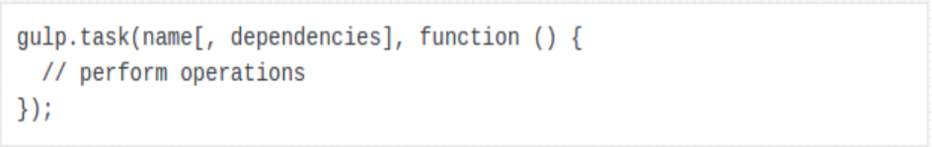
gulp.task
gulp.task defines a task. A task contains the operations you want to execute, where the operations are commonly provided by plugins.
name The name of the task. The task name will be accessible via the CLI, so make it something meaningful
dependencies An optional array of tasks to be completed prior to your task

Slide 8
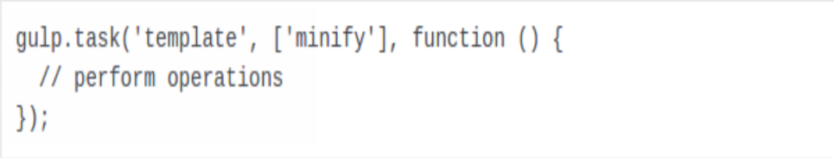
gulp.task
function
The function that performs the task’s operations. The function typically follows the pattern of collecting files from the file system, performing some operations provided by plugins, and writing the result back to the file system. We’ll take a closer look at this later. Below we are defining a task named template with a dependency on the minify task. The minify task will be executed and completed prior to the template task.

Slide 9
gulp.src
gulp.src will often be the first operation to perform within the task function as it collects the files from the file system on which your task will operate. It takes a file matching pattern (glob), representing the file structure to read, and returns a readable stream.
glob
The node-glob file pattern to read. The glob simply refers to pattern matching based on wildcard characters.

Slide 10
gulp.src
Options
An optional parameter to further define file criteria, such as the Current Working Directory, or whether your task needs the contents of the file read from the file system. Occasionally you may just need the file path and not the contents.
Below example is collecting all files with the js file extension located in the scripts directory or any of its subdirectories

Slide 11
gulp.dest
options gulp.dest writes files to the specified path and is commonly the last step in the task function.
path The output directory path. example writes the output files to the dist directory

Slide 12
gulp.watch
gulp.watch performs one or more tasks when specified files change. To avoid manually rerunning the build tasks after the developer makes changes, the watch method can be configured to do this automatically by executing certain tasks when particular files are changed
glob The node-glob file pattern that indicates the files to monitor for changes. options An optional parameter to further define file criteria, such as the Current Working Directory

Slide 13
What is Gunt
Grunt JS is a JavaScript task automation tool that make life better Allows us to Grunt JS is JavaScript task automation tool that make life better Allows us to work more efficiently with zero back-end effort with a small front-end time investment. Improves quality by automating tasks such as linting and unit testingwork more efficiently with zero back-end effort with a small front-end time investment. Improves quality by automating tasks such as linting
Grunt has a dependency upon Node.js and is managed through npm (Node Package Manager). Grunt uses a plugin architecture so that you may configure Grunt to run just the tasks you need for your project. These plugins, or modules, are also installed and managed through NPM.nd un testing

Slide 14
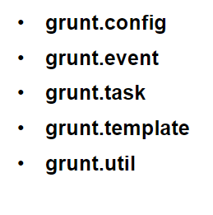

Slide 15
Sample Project Plugins
These are the plugins that will be installed into the sample project.
grunt-contrib-jshint - Validates JavaScript
grunt-contrib-cssmin - Minifies css
grunt-contrib-watch - Runs predefined tasks upon additions, changes, deletions
grunt-contrib-uglify - Minifies JS files using UglifyJS
grunt-contrib-less - Compiles LESS to CSS

Slide 16
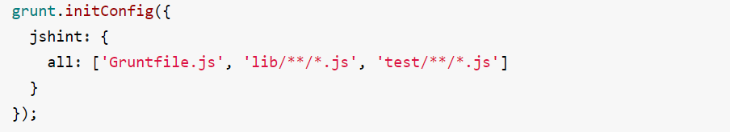
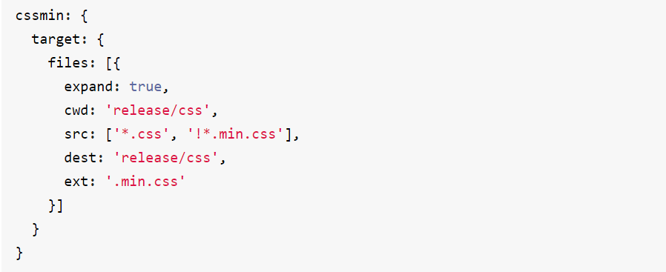

Slide 17
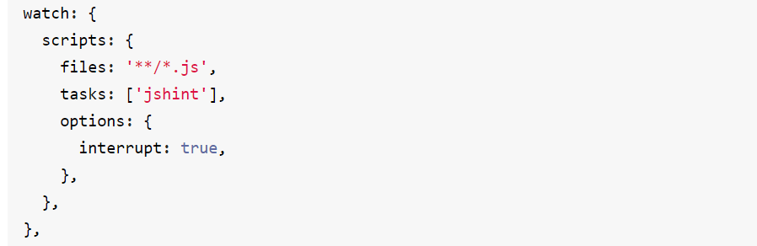
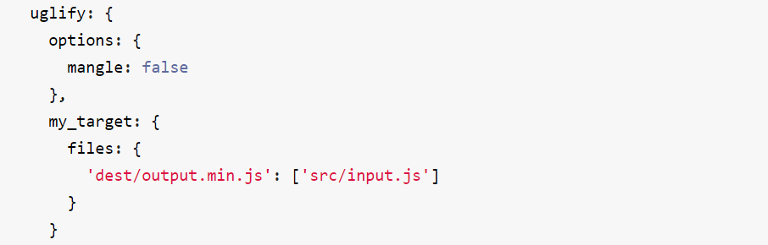

Slide 18
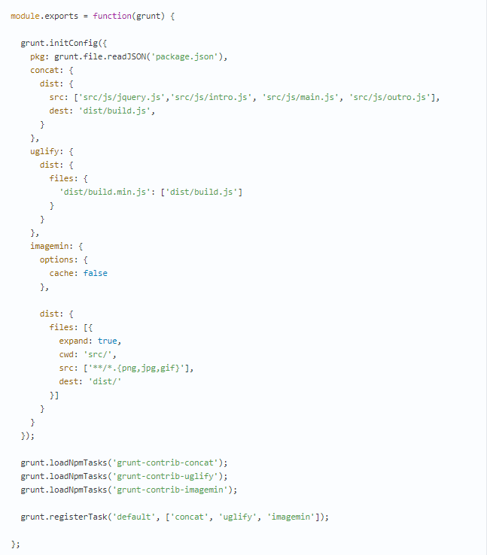

Slide 19


